Slide 1
IBM University Engagement Project Submission
“Exploring the Power of Agentic AI with IBM Granite and LangFlow”

Slide 2

Project Tile –Multi-Agent Agriculture Crop Yield Prediction System
Domain of Project – Agriculture
Student Name | Recent Passport Photo | Email ID | Mobile number [WhatsApp]
Sridevi Hiremath |  | hiremathsridevi@gmail.com | 8999697929

Slide 3
Problem Statement -
Problem Statement :Multi-Agent Agriculture Crop Yield Prediction System
The Challenge
Agriculture faces several challenges that directly affect crop productivity and farmer income. Farmers often struggle to predict crop yield accurately due to changing climatic conditions, irregular rainfall, soil fertility variations, pest and disease outbreaks, and limited access to timely agricultural information. Traditional farming decisions are often based on experience rather than data-driven insights, leading to inefficient resource utilization and reduced productivity. Additionally, agricultural knowledge is scattered across multiple sources, making it difficult for farmers to obtain accurate and actionable recommendations.
The Objective
The system aims to:
Predict crop yield using soil, weather, and historical agricultural data.
Recommend suitable crops based on environmental and soil conditions.
Provide weather-based farming advisories and risk assessments.
Detect and suggest preventive measures for crop diseases and pests.
Retrieve agricultural knowledge from trusted sources using RAG (Retrieval-Augmented Generation).
Deliver personalized recommendations through IBM Granite Models and LangFlow.
Improve agricultural productivity, sustainability, and farmer profitability.
Support data-driven decision-making through an interactive analytics dashboard.

Slide 4
Technology Used
Tech Stack (Mandatory)
Use any one of the following approaches:
LangFlow + IBM watsonx.ai + Granite Models
IBM Cloud Agentic Lab with IBM Granite Models
Replicate with LangChain + RAG + IBM Granite Models
I used LangFlow + IBM watsonx.ai + Granite Models

Slide 5
Proposed Solution -
Proposed Solution: AI-Powered Nutrition Agent
• Predict crop yield using soil, weather, and historical data.
• Recommend suitable crops based on environmental conditions.
• Retrieve agricultural knowledge using RAG from trusted sources.
• Provide weather-based alerts and farming recommendations.
• Offer pest and disease management guidance.
• Generate farm analytics and visualizations for better decision-making.
Multi-Agent System
Yield Prediction Agent – Predicts expected crop yield.
Crop Recommendation Agent – Suggests the best crop for cultivation.
Weather Intelligence Agent – Monitors weather conditions and risks.
Pest & Disease Advisory Agent – Provides preventive measures and treatments.
Knowledge Retrieval Agent – Retrieves agricultural information using RAG.
Farm Analytics Agent – Visualizes insights and performance metrics.

Slide 6
Langflow component Used -
1) Chat Input – Interface where users enter their queries, preferences, or meal details (text/voice/image).
2) IBM watsonx AI Agent - Processes user input using Granite models to generate personalized nutrition insights and recommendations.
3) Name of IBM Granite model - Granite-4.0-8B-Instruct → Fast, efficient for real-time diet recommendations
4) Chat output -Displays AI-generated responses such as diet plans, nutritional analysis, and health suggestions.
5) File component - Stores and retrieves user data, meal logs, and nutritional datasets for analysis and tracking.
6) Add name of any other component used.

Slide 7
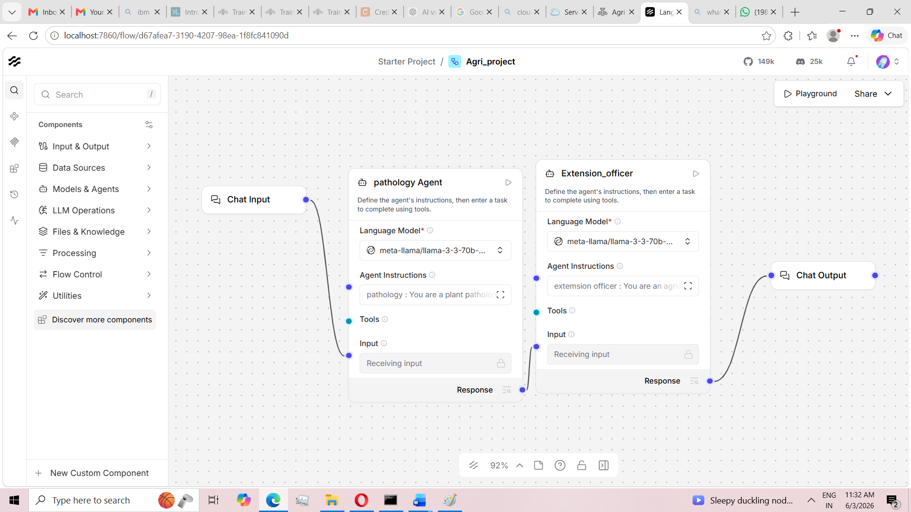
Langflow workflow -

Slide 8
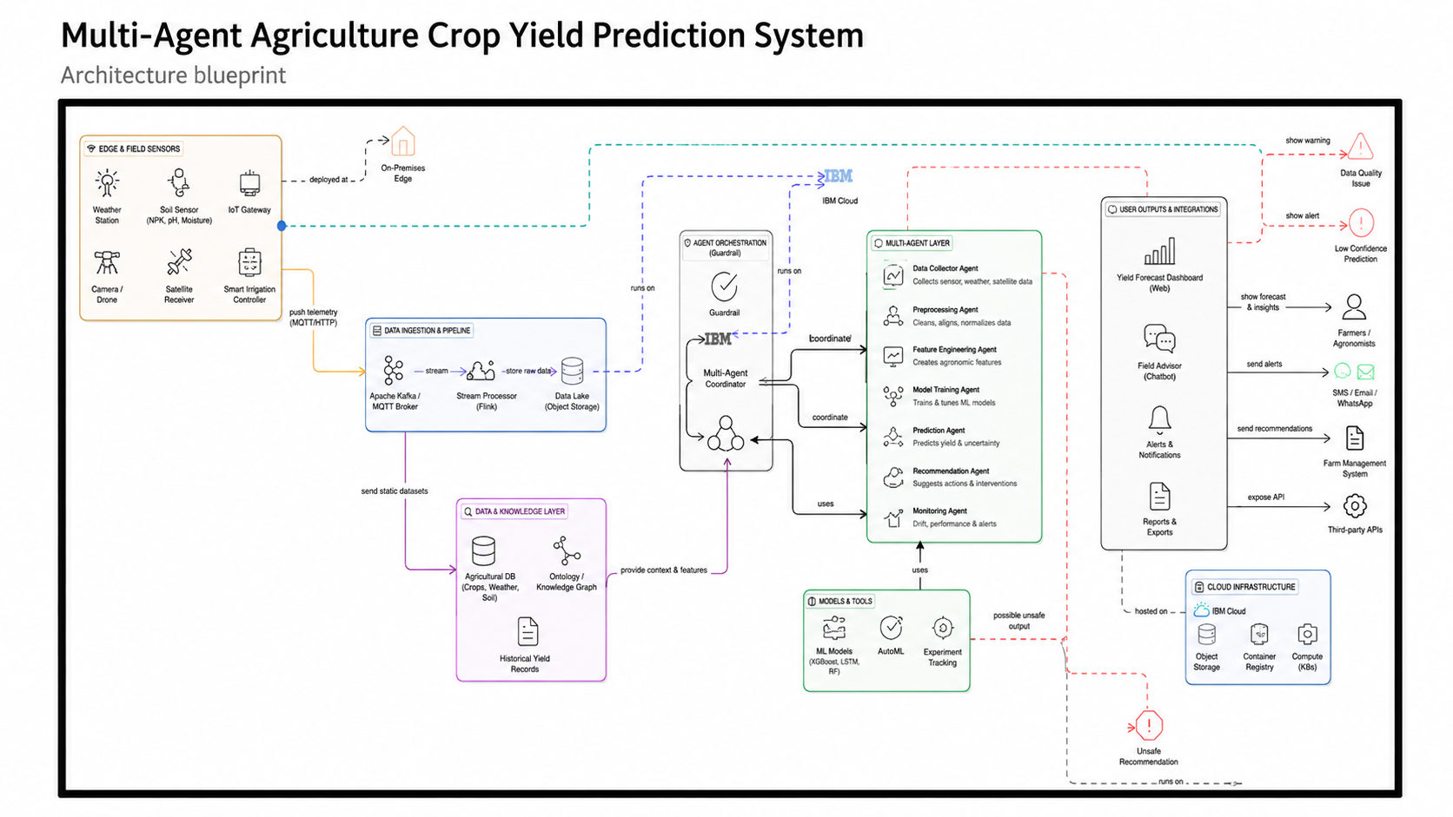
Architecture blueprint

Slide 9
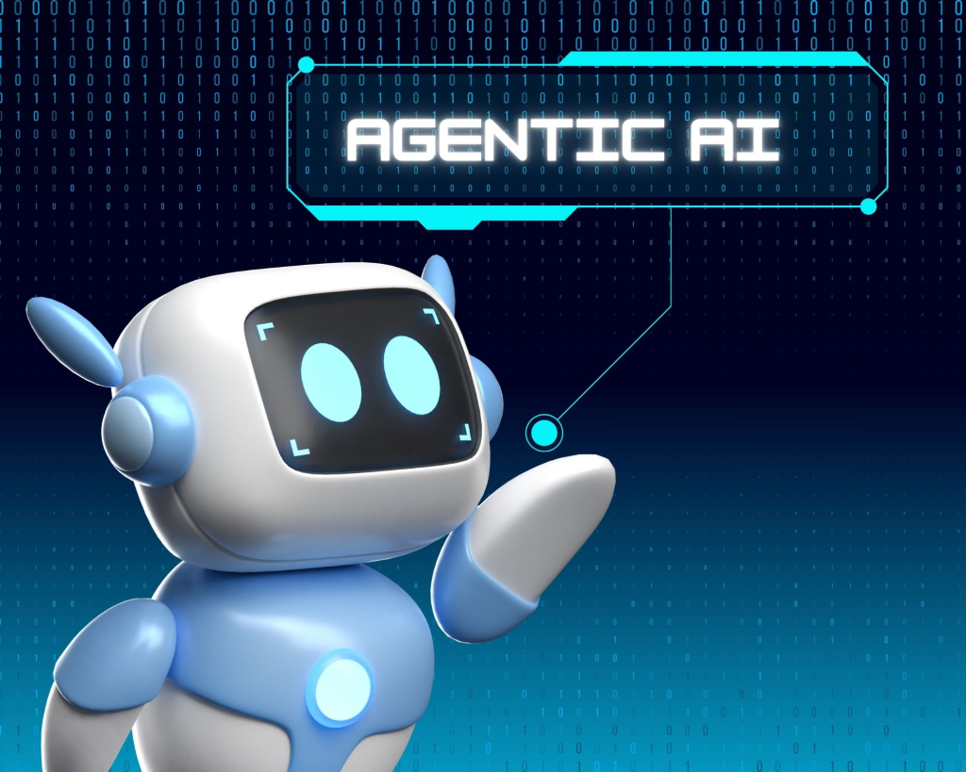
Role of Agentic AI in the solution
Role of Agentic AI in Nutrition Agent
Agentic AI plays a crucial role in the Multi-Agent Agriculture Crop Yield Prediction System by enabling multiple intelligent agents to work collaboratively and autonomously. Instead of relying on a single AI model, the system consists of specialized agents such as the Crop Recommendation Agent, Yield Prediction Agent, Weather Intelligence Agent, Pest & Disease Advisory Agent, and Knowledge Retrieval Agent. Each agent performs a specific task, analyzes relevant agricultural data, and shares insights with other agents to generate accurate and context-aware recommendations for farmers.
Agentic AI also enhances decision-making by continuously adapting to changing environmental conditions, soil characteristics, weather forecasts, and historical crop data. Through the integration of IBM Granite Models, LangFlow, and RAG-based knowledge retrieval, the agents can provide personalized crop recommendations, predict expected yield, identify potential risks, and suggest preventive measures. This collaborative and goal-driven approach transforms the system into an intelligent digital farming assistant that improves productivity, supports sustainable agriculture, and helps farmers make data-driven decisions.
.

Slide 10
Technology Used
Langflow platform -For designing and orchestrating multi-agent workflows visually
IBM Grainte model - for eg – ibm-granite-3-2-8b – For natural language understanding, reasoning, and personalization
IBM Cloud – It provides the infrastructure to build, deploy, and scale the Nutrition Agent efficiently. IBM Cloud enables a reliable, secure, and scalable environment for deploying the Nutrition Agent.
RAG– RAG to fetch real data first, then generate intelligent answers, making the Nutrition Agent more trustworthy and effective.
IBM Watsonx.ai - For model deployment, embeddings, and AI governance
Vector Database (FAISS/Chroma) – For RAG-based nutritional data retrieval

Slide 11
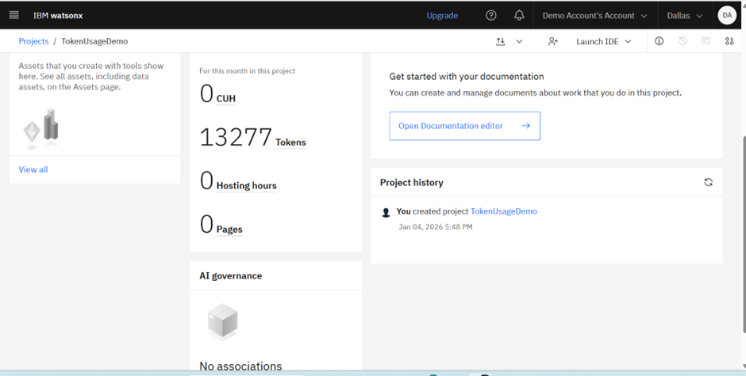
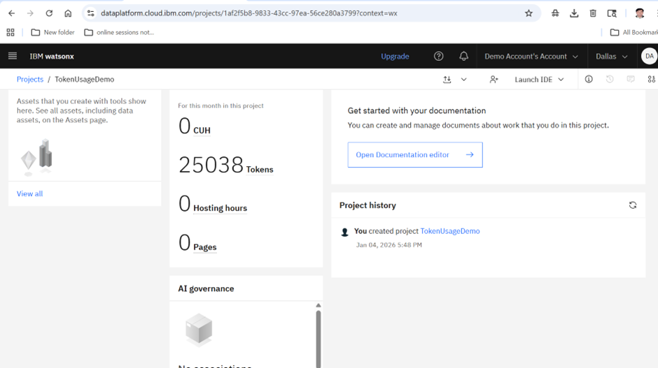
Token Usage
11,761 token are used
·
·
·

Slide 12
Novelty and Uniqueness
The proposed Multi-Agent Agriculture Crop Yield Prediction System offers a novel approach by integrating Agentic AI, Retrieval-Augmented Generation (RAG), Explainable AI (XAI), and predictive analytics into a single intelligent agricultural platform. Unlike traditional crop prediction systems that rely on a single machine learning model, this solution employs multiple specialized AI agents that collaborate to analyze soil properties, weather conditions, historical yield data, and agricultural knowledge to provide accurate and context-aware recommendations.
Multi-Agent AI Framework for collaborative decision-making.
• Crop Recommendation and Yield Prediction in a Single Platform.
• RAG-Based Agricultural Knowledge Retrieval for accurate and reliable responses.
• Explainable AI (SHAP & LIME) for transparent prediction results.
• Weather-Aware and Risk-Based Recommendations.
• Personalized Farmer Advisory System.
• IBM Granite and LangFlow Powered Agentic Architecture.

Slide 13
Git Hub Link:
https://github.com/hiremathsridevi-lang/Multi-Agent-Agriculture-Crop-Yield-Prediction-System.git
·
·
·

Slide 14
Future Scope
The proposed Multi-Agent Agriculture Crop Yield Prediction System can be further enhanced by integrating advanced technologies and real-time data sources to improve prediction accuracy and decision-making capabilities. Future versions of the system can incorporate IoT-based sensors to continuously monitor soil moisture, temperature, humidity, nutrient levels, and other environmental parameters. This real-time data can help farmers receive more accurate and timely recommendations for irrigation, fertilization, and crop management.
The system can also be extended to support satellite imagery, drone-based crop monitoring, and remote sensing technologies for large-scale agricultural analysis. By integrating computer vision and deep learning techniques, the platform can automatically detect crop diseases, pest infestations, and nutrient deficiencies at an early stage. Furthermore, multilingual support and mobile applications can make the solution accessible to farmers from different regions and language backgrounds.
·
·
·

Slide 15
Thank You!!!!!!!!!!!!

